Slide 1
Professional & Professionalism LECTURE # 4

Slide 2
Fair Use Notice
The material used in this presentation i.e., pictures/graphs/text, etc. is solely intended for educational/teaching purpose, offered free of cost to the students for use under special circumstances of Online Education due to COVID-19 Lockdown situation and may include copyrighted material - the use of which may not have been specifically authorized by Copyright Owners. It’s application constitutes Fair Use of any such copyrighted material as provided in globally accepted law of many countries. The contents of presentations are intended only for the attendees of the class being conducted by the presenter.

Slide 3


What Is Professional
Relating to or belonging to a profession.
A person engaged or qualified in a profession.
Example
Do you have any professional experience?
You should seek professional advice.
I was impressed by the calm, and professional way he handled the crisis.
The presentation was very professional.

Slide 4
Being Professional
Advance Expertise
Sophisticated skills and theoretical knowledge for objective analysis of problems in known area
Self- regulation
Independent of self-interest and towards the best interest of client/customer/end-user, sometimes guided by codes of conduct of the professional bodies.
Public Good
Not merely a salaried employee doing what the employer dictates. Working towards better welfare, safety, and health of society.

Slide 5
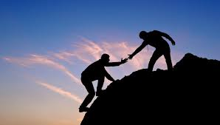

Models Of Professionals
Professional has some tasks to perform by which he acts as any of the following, which can be termed as Models of Professional.
Savior − A person who saves someone or something from any danger is called a Savior. A Professional who saves a group of people or a company from a technical danger can also be called a Savior
Guardian − A person who knows the direction towards a better future is known to be the Guardian for the same. A Professional who knows the direction in which there is scope for the technology to develop can also be called as Guardian. This Professional guidance provides the organization with innovative ideas for technological development.

Slide 6
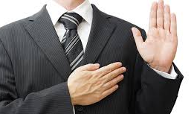

Models Of Professionals (Cont…)
Bureaucratic Servant − A person who is loyal and can solve problems when they occur using his own skills, is a Bureaucratic servant. A Professional who can be a loyal person to the organization and, also the one who solves the technical problems the company encounters, using his special skills can be termed as a Bureaucratic servant. The company relies on his decision-making capability for the future growth.
Social Servant − A person who works for the benefit of the society without any selfish interest and does not work on any business grounds, is called a Social servant. A Professional who receives a task as part of the organization’s concern for the society considering the directives laid by the society and accomplishes the assigned tasks can be termed as a Social Servant. He knows what the society needs.

Slide 7

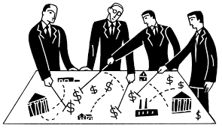
Models Of Professionals (Cont…)
Social Enabler or Catalyst − A person who makes the society understand its welfare and works towards the benefits of the people in it, is a Social Enabler. A Professional who plays a vital role in a company and helps company along with society to understand their needs and supports their decisions in work can be termed as a Social Enabler or Catalyst. This person quickens the procedure and helps maintain good environment in the company.
Game Player − A person who plays a game according to the rules given is a Game player in general. A Professional who acts as neither a servant nor a master but provides his services and plans his works according to the economic game rules in a given time, can be termed as a Game player. He is smart enough to handle the economic conditions of the company.

Slide 8

Professionalism
Professionalism is a word, it’s an Attitude.
The way in which an individual conducts oneself in certain situation .
The way you speak
The way you dress
The way you are organized
It is setting standards and complying with them.

Slide 9
Professionalism covers comprehensively all areas of practice of a particular profession. It requires skills and responsibilities involved in profession. Professionalism implies a certain set of attitudes.
The art of Professionalism can be understood as the practice of doing the right thing, not because how one feels but regardless of how one feels. Professionals make a profession of the specific kind of activity and conduct to which they commit themselves and to which they can be expected to conform. Moral ideals specify virtue, i.e., desirable feature of character. Virtues are desirable ways of relating to other individuals, groups and organizations. Virtues involve motives, attitudes and emotions.

Slide 10
The virtues represent excellence in core moral behavior. The essentials for any professional to excel in the profession are behavior, skills and knowledge. The behavior shows the moral ideology of the professional.
The moral ideals specify the virtue, i.e., the desirable character traits that talk a lot about the motives, attitude and emotions of an individual.
Public spirited virtues
Proficiency virtues
Teamwork virtues
Self-governance virtues
The virtues mentioned above show the professional responsibility of an individual. Hence, the professionalism that comes in with these virtues is called Responsible Professionalism. Let us now understand each virtue in detail.

Slide 11
Public-spirited Virtues
A Professional should focus on the good of the clients and the public at large, which means no harm should be done intentionally. The code of professional conduct is to avoiding harm and protecting, as well as promoting the public safety, health and welfare.
Proficiency Virtues
These refer to the virtues followed in the profession according to the talent and intellect of a professional. The moral values that include this virtue are competence and diligence. The competence is being successful in the job being done and the diligence is taking care and having alertness to dangers in the job. Creativity should also be present in accomplishing the assigned task.
Teamwork Virtues
These virtues represent the coordination among team members which means working successfully with other professionals. These include cooperative nature along with loyalty and respect towards their organization, which makes the Professional to motivate the other team professionals to work towards their valuable goals.
Self-governance Virtues
These virtues are concerned with moral responsibilities which represent integrity and self-respect of the person. The integrity actually means the moral integrity which refers to the actions, attitude and emotions of the person concerned during his professional period.
The self-governance virtues center on commitment, courage, self-discipline, perseverance, self-respect and integrity. The truthfulness and trustworthiness which represent his honesty are the crucial moral values to be kept up by a professional.

Slide 12

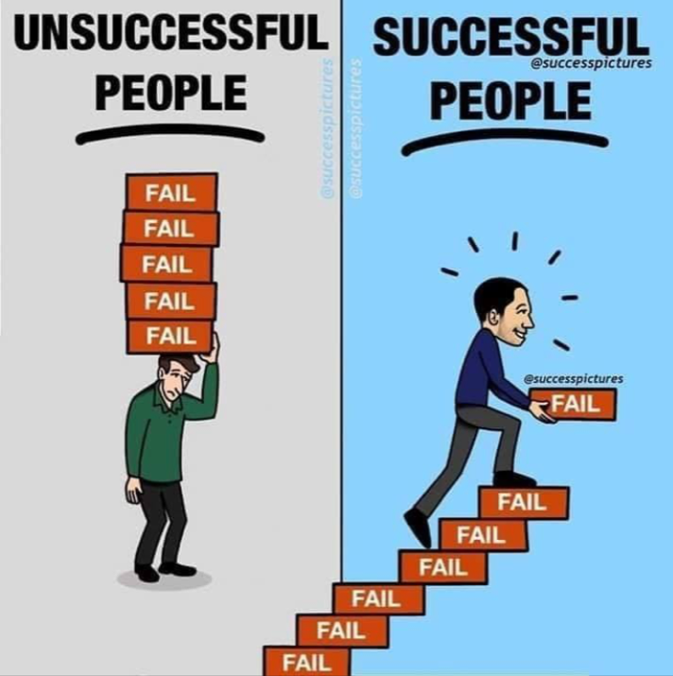



Lesson For Life

Slide 13
Thank you… Questions….??? If Any…

